Slide 1
ETAT-PLUS EMERGENCY TRIAGE ASSESSMENT &TREATMENT
PEADIATRIC EMERGENCIES-NURSING

Slide 2
INTRODUCTION
Many deaths in hospital occur within 24 hours of admission. Some of these deaths can be prevented if very sick children are quickly identified on their arrival and treatment is started without delay. In many hospitals around the world, children are not checked before a senior health worker examines them; as a result, some seriously ill patients have to wait a very long time before they are seen and treated.
Children are known to have died of a treatable condition when waiting in the queue for their turn.
The idea of triage is to prevent this from happening. The word “triage” means sorting. The use of triage to prioritize the critically ill dates back to the early 19th century, when this was developed by military surgeons in the Napoleonic war between France and Russia.

Slide 3
Triage is the process of rapidly examining sick children when they first arrive in order to place them in one of the following categories:
Those with EMERGENCY SIGNS who require immediate emergency treatment.
Those with PRIORITY SIGNS who should be given priority in the queue so they can be rapidly assessed and treated without delay.
Those who have no emergency or priority signs and are NON-URGENT cases. These children can wait their turn in the queue for assessment and treatment. The majority of sick children will be non-urgent and will not require emergency treatment.

Slide 4
Ideally, all children should be checked on their arrival by a person who is trained to assess how ill they are. This person decides whether the child will be seen immediately and receive life-saving treatment, or will be seen soon, or can safely wait for his or her turn to be examined.

Slide 5
Categories after triage: | Action required:
EMERGENCY CASES | Need immediate emergency treatment
PRIORITY CASES | Need assessment and rapid attention
QUEUE or NON-URGENT CASES | Can wait their turn in the queue.

Slide 6
The ABCD concept
Triage of patients involves looking for signs of serious illness or injury. These emergency signs relate to the;
Airway-Breathing-Circulation/Consciousness- Dehydration and are easily remembered as “ABCD”.
Each letter refers to an emergency sign which, when positive, should alert you to a patient who is seriously ill and needs immediate assessment and treatment.

Slide 7
A -Airway
B- Breathing
C- Circulation
C-coma
C-convulsion
D- Dehydration (severe

Slide 8
First, check for emergency signs in three steps:
Step 1. Check whether there is any airway or breathing problem; start immediate treatment to restore breathing. Manage the airway and give oxygen.
Step 2. Quickly check whether the child is in shock or has diarrhoea with severe dehydration. Give oxygen start IV fluid resuscitation. In trauma, if there is external bleeding, compress the wound to stop further blood loss.
Step 3. Quickly determine whether the child is unconscious or convulsing. Give IV glucose for hypoglycaemia and / or an anti-convulsant for convulsing.

Slide 9
Emergency signs include:
■ obstructed or absent breathing
■ severe respiratory distress
■ central cyanosis
■ signs of shock (cold hands, capillary refi ll time longer than 3 s, high heart rate with weak pulse, and low or unmeasurable blood pressure)
■ coma (or seriously reduced level of consciousness)
■ convulsions
■ signs of severe dehydration in a child with diarrhoea (lethargy, sunken eyes, very slow return after pinching the skin or any two of these).
Children with these signs require immediate emergency treatment to avert death.

Slide 10
Priority signs
Besides the group of emergency signs described above, there are priority signs, which should alert you to a child who needs prompt, but not emergency assessment. These signs can be remembered with the symbols 3 TPR - MOB:
Tiny baby: any sick child aged under two months
Temperature: child is very hot
Trauma or other urgent surgical condition
Pallor (severe)
Poisoning
Pain (severe)
Respiratory distress
Restless, continuously irritable, or lethargic
Referral (urgent)
Malnutrition: Visible severe wasting
Oedema of both feet
Burns

Slide 11
Triage of sick children: Emergency Signs: If history of trauma ensure cervical spine is protected
Airway & Breathing
Obstructed breathing
Central Cyanosis
Severe respiratory distress
Weak / absent breathing
Immediate transfer to emergency area:
Start Life support procedures
Give oxygen
Weigh if possible
Cold Hands with:
Capillary refill > 3seconds
Weak + fast pulse
Slow (<60bpm) or absent pulse
Circulation
Coma / convulsing / confusion : AVPU = ‘P or U’ or Convulsions
Diarrhoea with sunken eyes → assessment / treatment for severe dehydration
Priority signs
Tiny - Sick infant aged < 2 months
Temperature – very high > 39.5⁰C
Trauma – major trauma
Pain – child in severe pain
Poisoning – mother reports poisoning
Pallor – severe palmar pallor
Restless / Irritable / Floppy
Respiratory distress
Referral – has an urgent referral letter
Malnutrition - Visible severe wasting
Oedema of both feet
Burns – severe burns
Front of the Queue - Clinical review as soon as possible:
Weigh
Baseline observations
Non-urgent – Children with none of the above signs.

Slide 12
The frequency with which children showing some of these priority signs appear in the outpatient department depends on the local epidemiology. The signs might need to be adapted accordingly, for example by including signs for common severe conditions which cannot wait in your setting.
The triaging process
Triaging should not take much time. For a child who does not have emergency signs, it takes on average 20 seconds.
The health worker should learn to assess several signs at the same time. A child who is smiling or crying does not have severe respiratory distress, shock or coma. The health worker looks at the child, observes the chest for breathing and priority signs such as severe malnutrition and listens to abnormal sounds such as stridor or grunting.

Slide 13
Several methods are available to facilitate the triaging process. One example is a stamp being used in Malawi consisting of the “ABCD” signs in which the health worker circles the correct step and initiates emergency treatment “E” or puts them in priority groups “P” or “Q” for children who can wait in the queue.
Colours can also be used for differentiating the three groups, giving a red sticker to emergency cases, a yellow for priority and green for the queue.

Slide 14
A Airway
B Breathing
C Circulation
Cm Coma
Cn Convulsion
D Dehydration (severe)
E Emergency
P Priority
Q Queue

Slide 15
WHEN AND WHERE SHOULD TRIAGING TAKE PLACE?
Triage should be carried out as soon as a sick child arrives in the hospital, well before any administrative procedure such as registration. This may require reorganizing the flow of patients in some locations.
Triage can be carried out in different locations – e.g. in the outpatient queue, in the emergency room, or in a ward if the child has been brought directly to the ward at night.
In some settings, triage is done in all these places. Emergency treatment can be given wherever there is room for a bed or trolley for the sick child and enough space for the staff to work on the patient, and where appropriate drugs and supplies are easily accessible.
If a child with emergency signs is identified in the outpatient queue, he/she must quickly be taken to a place where treatment can be provided immediately, e.g. the emergency room or ward.

Slide 16
WHO SHOULD TRIAGE?
All clinical staff involved in the care of sick children should be prepared to carry out rapid assessment in order to identify the few who are severely ill and require emergency treatment.
If possible, all such staff should be able to give initial emergency treatment, as described in the flowchart and treatment charts.
In addition, people such as gatemen, record clerks, cleaners, janitors who have early patient contact should be trained in triage for emergency signs and should know where to send people for immediate management.

Slide 17
HOW TO TRIAGE?
Keep in mind the ABCD steps: Airway, Breathing, Circulation, Coma, Convulsion, and Dehydration.
When ABCD has been completed the child should be assigned to one of:
Emergency (E)
Priority (P)
Non-urgent and placed in the Queue (Q).
EMERGENCY SIGNS
Triage of patients involves looking for signs of serious illness or injury. These emergency signs are connected to the Airway - Breathing - Circulation/Consciousness - Dehydration and are easily remembered as ABCD. Each letter refers to an emergency sign which, when positive, should alert you to a child who is seriously ill and needs immediate assessment and treatment.

Slide 18
1. Assess airway and breathing
The most common cause of breathing problems in children during emergencies is pneumonia. However, other causes can also lead to breathing problems, including anemia, sepsis, shock and exposure to smoke. Obstructed breathing can be caused by infection (for example croup) or an object in the airway.
The child has an airway or breathing problem if any of these signs are present.
Child is not breathing.
Child has central cyanosis (bluish color).
Severe respiratory distress with fast breathing or chest indrawing.

Slide 19
Assess for an airway or breathing problem.
Is the child breathing?
Is there central cyanosis?
Is there severe respiratory distress?
If there is severe respiratory distress, does breathing appear obstructed? The child with obstructed breathing will appear to have difficulty breathing with little air entering the lungs. Sometimes the child will make a sound (stridor) as some air moves past the obstruction.
Assessment of fast breathing.
Count breaths FOR ONE FULL MINUTE to assess fast breathing.

Slide 20
If the child is: | The child has fast breathing if you count:
Less than 2 months | 60 breaths per minute or more
2 months up to 12 months | 50 breaths per minute or more
12 months up to 5 years | 40 breaths per minute or more

Slide 21
Look for chest indrawing.
Chest indrawing is the inward movement of the lower chest wall when the child breathes in and is a sign of respiratory distress. Chest indrawing does not refer to inward movement of the soft tissue between the ribs.

Slide 22
Emergency management of airway and breathing problems
An airway or breathing problem is life-threatening. This child needs immediate treatment to improve or restore breathing.
If the airway appears obstructed, open the airway by tilting the head back slightly.
If the child may have a neck injury, do not tilt the head, but use the jaw thrust without head tilt
Give oxygen if possible.
Provide management for the underlying cause of airway or breathing problem

Slide 23
Cough (pneumonia)
Pallor (anemia)
Fever (malaria, meningitis, sepsis)
Shock (see below)
Poisoning .

Slide 24

Figure Jaw thrust without head tilt when trauma is suspected.

Slide 25
2. Assess the circulation for signs of shock
Common causes of shock include dehydration from diarrhoea, sepsis, anaemia (for e.g. due to severe blood loss after trauma, poisoning or severe malaria).
The child has shock (a blood circulation problem) if the following signs are present:
cold hands AND
capillary refill longer than 3 seconds
OR weak and fast pulse.
Capillary refill is the amount of time it takes for the pink colour to return after applying pressure to whiten the nail of the thumb or big toe for 3 seconds.

Slide 26
Assess the child's circulation.
Is the child's hand cold?
If yes, is the capillary refill longer than 3 seconds? Classify the child as having SHOCK if the capillary refill takes longer than 3 seconds.
Check the pulse. Is the pulse weak and rapid?
To check the pulse, first feel for the radial pulse. If it is strong and not obviously rapid, the pulse is adequate. No further examination is needed.
If you cannot feel a radial pulse or if it feels weak, check a more central pulse.
In an infant (age less than one year), move up the forearm and try to feel the brachial pulse, or if the infant is lying down, feel for the femoral pulse.
If the more central pulse feels weak, decide if it also seems rapid.
Classify the child as having SHOCK if the pulse is weak and rapid.

Slide 27
Emergency management of the shocked child
A child who is in shock must be given intravenous (IV) fluids rapidly. A bolus (large volume) of fluid is pushed in rapidly in a child with shock who does not have severe malnutrition.
Insert an intravenous (IV) catheter and begin giving fluids rapidly for shock. Normal (0.9%) saline or Ringer's lactate solution can be used for rapid fluid replacement. Give 20 mL/kg of fluid and reassess the signs of shock. 20 mL/kg boluses can be give two more times if signs of shock persist.
If you are not able to insert a peripheral intravenous (IV) catheter after 3 attempts, insert a scalp intravenous (IV) catheter or intraosseous line.
If the child has severe malnutrition, the fluid should be given more slowly and the child monitored very closely. Children with severe malnutrition can go into congestive heart failure from intravenous fluids.
Apply pressure to stop any bleeding.
Give oxygen if possible.

Slide 28
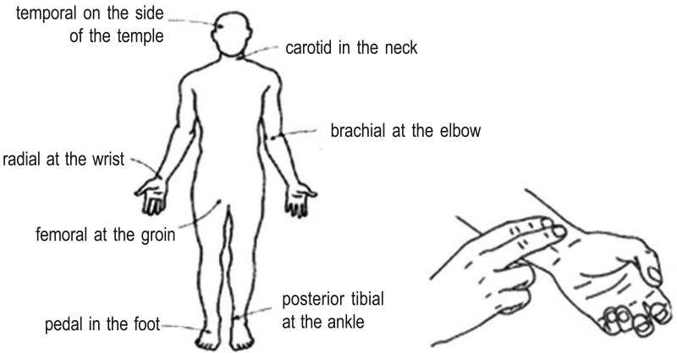
Location of the major arteries to assess the pulse

Slide 29
3. Assess for convulsions and coma
Common causes of convulsions in children include meningitis, cerebral malaria and head trauma.
Signs of convulsions include:
sudden loss of consciousness
uncontrolled, jerky movements of the limbs
stiffening of the child's arms and legs
unconscious during and after the convulsion.

Slide 30
Emergency management of the convulsing child
Treatment of the convulsing child includes the following steps:
Ensure the mouth and airway are clear, but do not insert anything into the mouth to keep it open
Turn the child on his or her side to avoid aspiration.
Give intravenous (IV) glucose.
Treat with diazepam or paraldehyde (phenobarbital for neonates)
Option 1: diazepam intravenously (IV) (0.3 mg/kg to a total dose of 10 mg) as slow infusion over 2 minutes
Option 2: diazepam rectally (0.5 mg/kg) administered by inserting a (1 mL) syringe without needle into the rectum
Option 3: paraldehyde (0.2 mL/kg to maximum of 10 mL) by deep intramuscular (IM) injection into the anterior (front) thigh
Option 4: paraldehyde rectally (0.4 mL/kg) administered by inserting a (1 mL) syringe without needle into the rectum
For neonates (< 1 month of age): Phenobarbital 20 mg/kg IV/IM. If convulsions continue, add 10 mg/kg after 30 minutes.
If the child is conscious, feed the child frequently every 2 hours.

Slide 31
Common causes of loss of consciousness or lethargy or irritability and restlessness include meningitis, sepsis, dehydration, malaria, low blood sugar and severe anemia.
Assess the child for unconsciousness or lethargy
If the child is not awake and alert, try to arouse the child by talking to him or her.
Then shake the arm to try to wake the child.
If there is no response to shaking, squeeze the nail bed of a fingernail to cause mild pain.
If the child does not respond to voice or shaking of the arm, the child is unconscious.

Slide 32
Emergency management of the unconscious child
Treatment of the unconscious child includes:
management of the airway
positioning the child (in case of trauma, stabilize neck first so that it does not move)
giving intravenous (IV) glucose
management of the underlying cause of loss of consciousness in children WITH fever:
malaria, meningitis, sepsis
management of the underlying cause of loss of consciousness in children WITHOUT fever:
Dehydration
Anaemia
Poisoning .

Slide 33
Assess the child for irritability or restlessness by looking for:
difficulty in calming the child.
persistent signs of discomfort or crying.
continued, abnormal movement without periods of calm.
If you suspect trauma which might have affected the neck or spine, do not move the head or neck as you treat the child and continue the assessment.
Ask if the child has had trauma to his head or neck, or a fall which could have damaged his spine.
Look for bruises or other signs of head or neck trauma.
For more detailed assessment and management of the child with head or neck trauma, go to chapter 10.

Slide 34
Causes of low blood glucose include sepsis, diarrhea, malaria and burns.
How to measure the blood glucose using a glucose strip:
Put a drop of the child's blood on the strip.
After 60 seconds, wash the blood off gently with drops of cold water.
Compare the color with the key on the side of the bottle.
If the blood glucose is less than 2.5 mmol/litre, the child has low blood glucose and needs treatment.
For management of the child with low blood glucose, go to chapter 2.

Slide 35
Management of the child with low blood sugar (glucose)
If the child is unconscious, start an intravenous (IV) infusion of glucose solution
Once you are sure that the IV is running well, give 5 mL/kg of 10% glucose solution (D10) over a few minutes, or give 1 mL/kg of 50% glucose solution (D50) by very slow push.
Then insert a nasogastric tube and begin feeding every 2 hours.

Slide 36
4. Assess for severe dehydration
Diarrhoea is one of the commonest causes of death among under-five children. Death most commonly is due to dehydration. Children with signs of severe dehydration (such as sunken eyes, severely reduced skin pinch, lethargy or unconsciousness, or inability to drink or breastfeed) need emergency management with replacement fluids.
For more detailed assessment and management of the child with severe dehydration, go to chapter 3.

Slide 38
To assess if the child has circulation problems you need to know:
􀂄 Does the child have warm hands?
􀂄 If not, is the capillary refill time longer than 3 seconds?
􀂄 And is the pulse weak and fast?
In the older child the radial pulse may be used; however, in the infant, the brachial or femoral pulses may need to be felt.
To assess for coma you need to know:
A rapid assessment of conscious level can be made by assigning the patient to one of the AVPU categories:
A Alert
V responds to Voice
P responds to Pain
U Unresponsive

Slide 39
A child who is not alert but responds to voice is lethargic. If the assessment shows that the child does not respond to voice and only responds to pain (with targeted or untargeted movements), or does not respond at all, the level is at “P”
or “U”. We then refer to that child as having coma and the child needs to be treated accordingly.
To assess for dehydration you need to know:
􀂄 If the child is lethargic or unconscious
􀂄 If the child has sunken eyes
􀂄 If the skin pinch goes back very slowly
When ABCD has been completed and there are no emergency signs, continue to assess the priority signs.

Slide 40
NOTE :If the child has any sign of the ABCD, it means the child has an emergency “E” sign and emergency treatment should start immediately.
ASSESSING PRIORITY SIGNS
If the child does not have any of the E signs, the health worker proceeds to assess the child on the priority signs. This should not take more than few seconds.
Some of these signs will have been noticed during the ABCD triage discussed so far, and others need to be rechecked. Follow the 3 TPR-MOB to quickly complete this section.
1. Tiny infant (less than two months of age)
If the child appears very young, ask the mother his age. If the child is obviously not a young infant, you do not need to ask this question.
Small infants are more difficult to assess properly, more prone to getting infections (from other patients), and more likely to deteriorate quickly if unwell. All tiny babies of under two months should therefore be seen as a priority

Slide 41
2. Temperature: Hot (fever - high Temperature)
A child that feels very hot may have high fever. Children with high fever on touch need prompt treatment.
Take the waiting child to the front of the queue and take locally adopted action, like having the temperature checked by thermometer, giving an antipyretic, or doing investigations like a blood film for malaria.
3. Severe Trauma (or other urgent surgical condition)
Usually this is an obvious case, but one needs to think of acute abdomen, fractures and head injuries in this category.

Slide 42
4. Severe Pallor
Pallor is unusual paleness of the skin, and severe pallor is a sign of severe anaemia which might need urgent transfusion.
It can be detected by comparing the child’s palms with your own. If the palms are very pale (almost paper-white), the child is severely anaemic.
5. Poisoning
A child with a history of swallowing drugs or other dangerous substances needs to be assessed immediately, as he can deteriorate rapidly and might need specific treatments depending on the substance taken. The mother will tell you if she has brought the child because of possible intoxication

Slide 43
6. Severe Pain
If a child has severe pain and is in agony, she/he should be prioritized to receive early full assessment and pain relief. Severe pain may be due to severe conditions such as acute abdomen, meningitis, etc.
7. Lethargy or Irritable and Restless
Recall from your assessment of coma with the AVPU scale whether the child was lethargic. A lethargic child responds to voice but is drowsy and uninterested (V in the AVPU scale).
The continuously irritable or restless child is conscious but cries constantly and will not settle.

Slide 44
8. Respiratory distress
When you assessed the airway and breathing, did you observe any respiratory distress? If the child has severe respiratory distress, it is an emergency. There may be signs present that you do not think are severe, e.g. lower chest wall indrawing (not severe), or difficulty in breathing. In this case, the child does not require emergency treatment but will need urgent assessment. Decisions on the severity of respiratory distress come with practice. If you have any doubts, have the child seen and treated immediately.
9. Urgent Referral
The child may have been sent from another clinic. Ask the mother if she was referred from another facility and for any note that may have been given to her.
Read the note carefully and determine if the child has an urgent problem.

Slide 45
10. Severe wasting (Severe Malnutrition)
A child with visible severe wasting has a form of malnutrition called marasmus. To assess for this sign, look rapidly at the arms and legs as well as the child’s chest.
Oedema of both feet
Oedema of both feet is an important diagnostic feature of kwashiorkor, another form of severe malnutrition. Other signs are changes in the skin and hair.

Slide 46
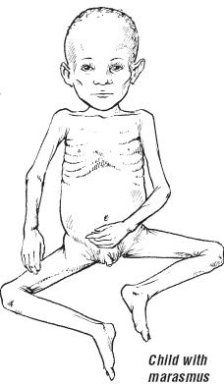
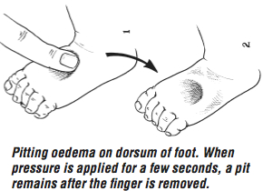
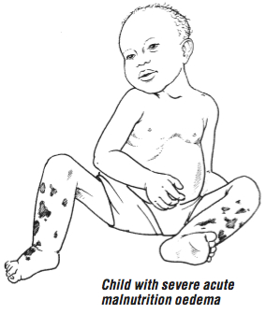

Slide 47
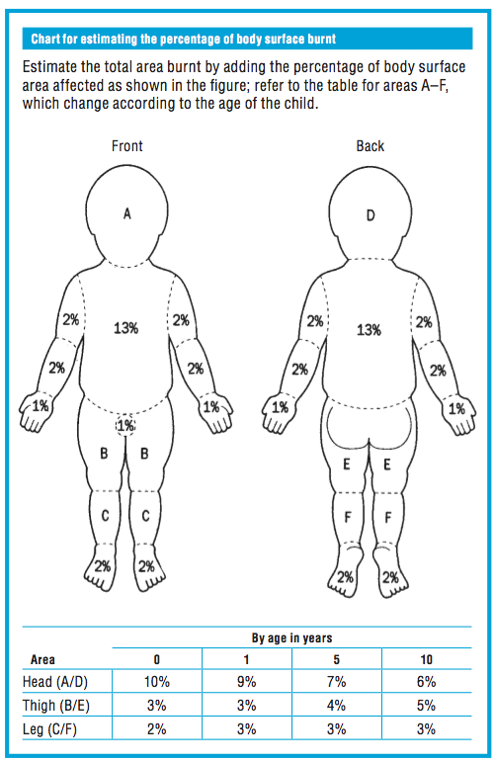

Slide 48
11.Major Burn
Burns are extremely painful and children who seem quite well can deteriorate rapidly. If the burn occurred recently, it is still worthwhile to cool the burnt area with water, for example, by sitting the child in a bathtub with cool water. Any child with a major burn, trauma or other surgical condition needs to be seen quickly. Get surgical help or follow surgical guidelines.
Triage all sick children. When a child with emergency signs is identified, take to the emergency room or treatment area and start the appropriate emergency
treatments immediately. Do not proceed to the next step before treatment is begun for a positive sign.

Slide 49
NEONATAL RESUSCITATION (ESSENTIAL NEW BORN CARE)
Most newborns require only simple supportive care at and after delivery.
Dry the infant with a clean towel.
Observe the infant while drying (see Chart)
Maintain the infant in skin-to-skin contact position with the mother.
Cover the infant to prevent heat loss.
Clamp and cut the cord at least 1 min after birth.
Encourage the mother to initiate breastfeeding within the first hour.
Skin-to-skin contact and early breastfeeding are the best ways to keep an infant warm and prevent hypoglycaemia. Term and low-birth-weight neonates weighing > 1200 g who do not have complications and are clinically stable should be put in skin-to-skin contact with the mother soon after birth after they have been dried thoroughly to prevent hypothermia.

Slide 50
Resuscitation may be required for some infants, such as those born to mothers with chronic illness, to mothers who had a previous fetal or neonatal death, to mothers with pre-eclampsia, in multiple pregnancies, in preterm delivery, in abnormal presentation of the fetus, infants with a prolapsed cord, or after prolonged labour, rupture of membranes or meconium-stained liquor
For many infants, resuscitation cannot be anticipated before delivery. therefore:
be prepared for resuscitation at every delivery, follow the assessment steps of chart

Slide 51
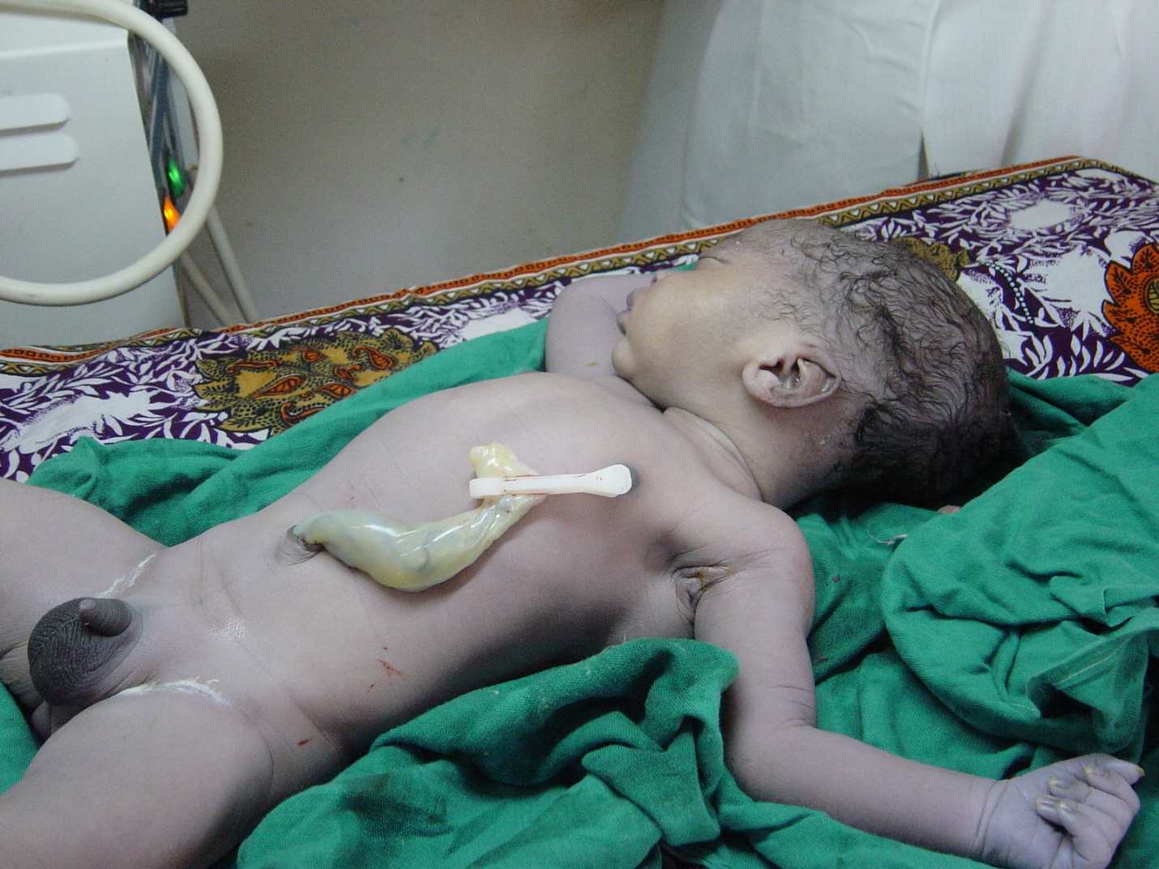
Why do babies need resuscitation – what is the main problem?

Slide 52
Before we begin resuscitation however we must make sure the environment is appropriate.
Babies are born covered with fluid and have a big surface are to volume ratio, they will lose heat rapidly from evaporation of this fluid, from loss of heat to the air (convection) and loss of heat to cold surfaces (conduction).
If a baby gets cold this; a) Turns off surfactant production – the lubricant that allows the lungs to open and take in air after 9 months filled with fluid
b) Increases its need for glucose as an energy source to make heat and so can help make a baby hypoglycaemic.

Slide 53
Equipment
Clock
Warm dry towels
Firm stable surface & Lighting
Bag Valve device (not damaged)
Face masks
Wide bore sucker
(Guedel airways)
(Oxygen)
Laryngoscope
ET tubes (sizes 2.0 to 4.0)
Drugs
Adrenaline
(Volume)
Scissors and tape

Slide 54
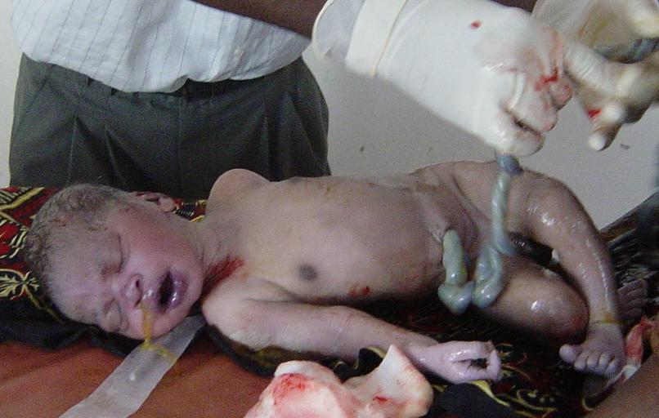
Resuscitation – Step 1
(Equipment routinely checked and working)
(Define tasks – resuscitation nurse / who is in charge to provide an effective team)
Dry and stimulate
10-20 seconds
Observe:
Colour / Tone / Cry / Respiratory Effort
Warm place
? Hanging upside down
? Slapping the bottom

Slide 55
The first two bullet points are in brackets because they are an essential part of all resuscitation events but need to be thought about before the need for resuscitation arises.
Equipment for resuscitation must always be ready – routines for checking things on each shift must be in place.
Ideally highly skilled providers would be available – use them – if people are resuscitating together it is very important that one person is in charge and directing the overall approach.
The first priority therefore after the cord is cut is to dry the baby, wrap it in clean, dry towels and move it to a place where it can be kept warm while any further resuscitation is commenced.
What do people think about hanging the baby upside down to ‘let the fluid in the lungs drain out’, or slapping the baby’s bottom to stimulate it to cry?
Hanging upside down achieves nothing in terms of clearing fluid – fluid is squeezed out of the chest during delivery and reabsorbed once the lungs have been expanded by the first few breaths. There is also a danger to the hips from hanging a baby with poor muscular tone upside down.
The best way to stimulate the baby is the action of drying it with a towel – if it does not respond to this then slapping the bottom or pinching the feet will achieve nothing

Slide 56
Resuscitation – Step 2 – Airway
Dry and stimulate for 10-20 seconds
Observe:
Colour / Tone / Cry / Respiratory Effort
Baby Crying / Vigorous
The airway must be open and the baby must be breathing!
Check Heart Rate and if the baby continues to improve pass to mother – 95% of births!
Baby NOT Crying / Floppy
Dry and stimulate for 10-20 seconds
Baby NOT Crying / Floppy / Blue
Open / Clear the AIRWAY:
(Remove thick meconium from the mouth)
Neutral position
Look / Listen / Feel for BREATHING

Slide 57
After drying and placing in a warm place then resuscitation proceeds with ‘A’ for airway.
If after drying and keeping warm the baby is now crying then the airway must be open and the baby must be breathing! It is appropriate to quickly check the heart rate, colour and tone but in 99% of cases the crying baby will be fine and can be passed immediately to the mother – the best place to keep the baby warm is in skin to skin contact on the mothers chest.

Slide 58
If the baby is not crying, looks blue or white or is floppy then we need to deal with the ‘A’ for airway – even if the heart rate is 40!
If there has been thick meconium it makes sense to suction the mouth and pharynx as far as you can see – with a large bore suction tube or Yankauer sucker. It makes no sense to try sucking meconium with an 8F or 10F tube.
Passing the suction tube blindly down into the pharynx should not be done – this may worsen bradycardia (through vagal nerve stimulation).
If there is no history of thick meconium then routine suction is not necessary – suction tubes are a great way of spreading infection.
The priority now is to open the airway – this requires adequate positioning (see next slides)
After opening the airway has there been any effect – look, listen and feel for breath sounds

Slide 59
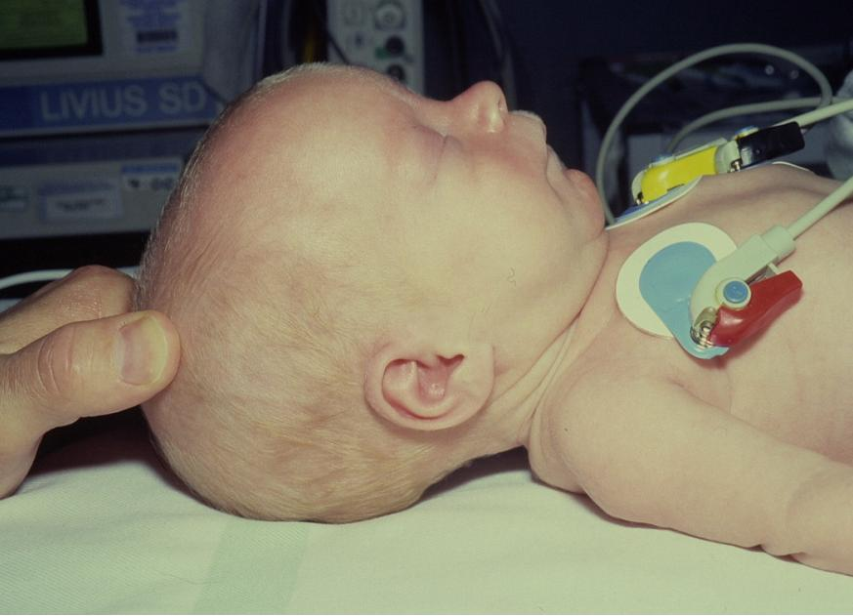
Airway opening 1

Slide 60
In the slide a normal term baby is lying on a flat surface.
Because the back of a baby’s head is large the natural position for a baby placed on such a hard surface is with the head flexed (tilted forwards with the chin on the chest).
This flexed position is a very good way of closing the airway.

Slide 61
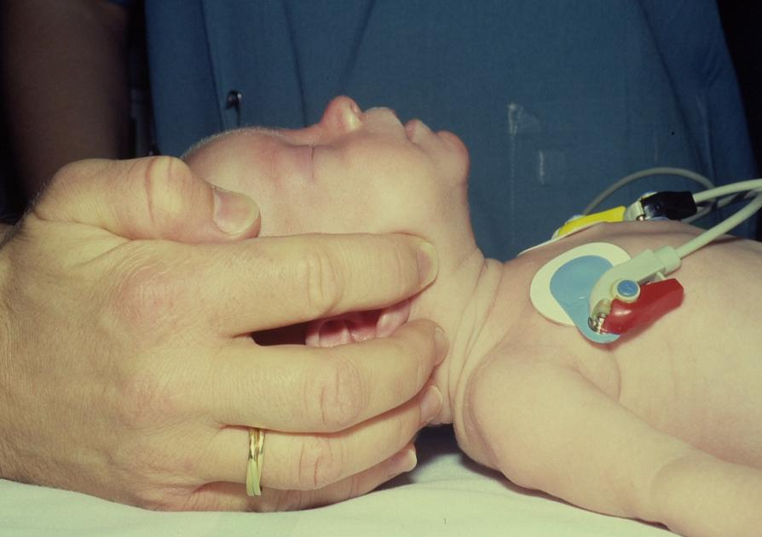
Airway opening 2

Slide 62
To open the airway we must do something about the position – moving it into what is called the ‘neutral position’ with the nostrils and lips making a line that is parallel to the line of the surface the baby is lying on.
In the picture the position is being achieved by lifting the jaw from the angle of the mandible and extending the neck a little (the jaw thrust). In most cases the head-tilt / chin lift approach is used (this is harder to show in a photo). Do not hyper-extend the neck so the jaw points to the ceiling – in babies this also blocks the airway.

Slide 63
Resuscitation – Step 3 – Breathing
Open / Clear the AIRWAY:
Look / Listen / Feel for BREATHING
Baby IS breathing by itself
Provide OXYGEN and check the heart rate.
Make sure the heart rate is rising and reaches >100 / min
Baby IS NOT breathing by itself
Open / Clear the AIRWAY:
Look / Listen / Feel for BREATHING
Baby IS NOT breathing by itself
5 Inflation breaths with Bag and Mask device
Slow inflation over 2-3 secs
Watch and make sure the chest rises
Do not over-inflate (LBW / Preterms)

Slide 64
) If the baby after positioning the airway begins to breath well – the chest is obviously expanding - then give oxygen and check the heart rate.
If the baby does not breathe after opening the airway by now 60 -90 seconds will have elapsed from the time of birth. It is therefore sensible to give 5 slow inflation breaths.
Alveoli before and after successful inflation

Slide 65
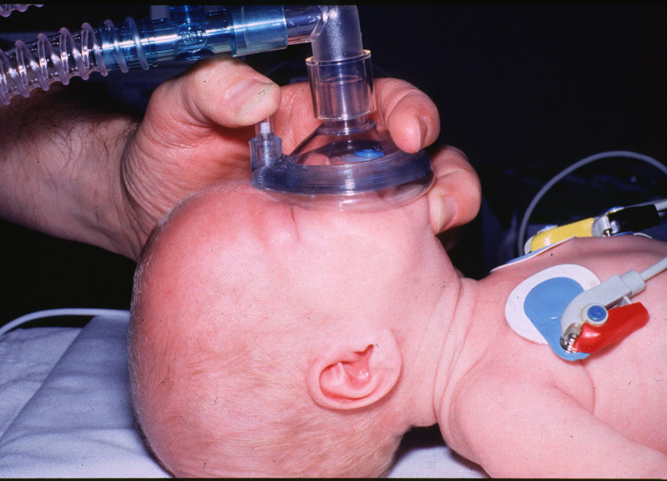
Resuscitation – Step 3 – Breathing

Slide 66
It is critical when assisting a baby to breath with a bag and mask that the airway position is maintained – if it is not then you cannot inflate the lungs.
It is also critical that the mask fits correctly – it should cover mouth and nose and not press on the eyes. A see through mask is ideal as it allows you to see the colour of the baby.
The most common problem with masks (other than wrong sizes) is that the air-filled cushion around the edge is punctured. If this happens it is impossible to get a good seal – BUY A NEW MASK!

Slide 67
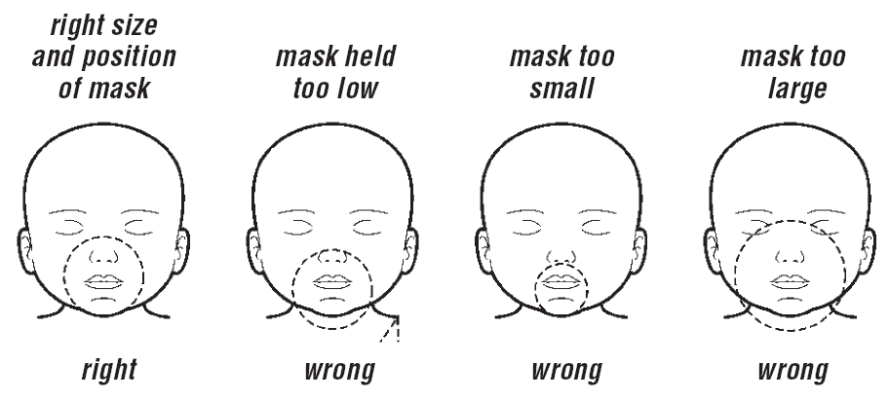

Slide 68
These are examples of how to size and fit a mask – soft round masks are often the easiest to use.
From left to right
Shows a correct mask fit
The mask goes over the chi and presses on the nose
Only the mouth is covered
The mask goes over the chin and presses on the eyes.

Slide 69
Resuscitation – Step 3 – Breathing
5 Inflation breaths with Bag and Mask device
Check Heart Rate
Heart Rate about 60 bpm or more
Heart Rate very slow, < 60 bpm
CALL FOR HELP!
Continue with B & M breathing for 30s to 1 min, rate of ~30 breaths/min and re-check HR and baby’s breathing.
After 1-2 mins most babies breathe normally with HR > 100 bpm.

Slide 70
After delivering 5 inflation breaths the heart rate should be checked for 5 – 10 seconds.
The best places to check are the umbilical stump or to listen with a stethoscope (the latter is actually preferred as the cord pulsation is on occasions unreliable….but is better than trying to feel a brachial or femoral in a newborn).
If the heart rate seems above 60 (1 beat per second) then continue with BVM ventilation for 30s at a rate of about 30 and then re-assess the baby’s airway and breathing AND heart rate.
If the chest has been rising then in most cases the baby will being to breathe AND the heart rate will be fast.

Slide 71
Resuscitation – Step 4 – Circulation
5 Inflation breaths with Bag and Mask device
Check Heart Rate
Heart Rate very slow, < 60 bpm
CALL FOR HELP!
Chest compressions
3 compressions to every one B & M breath
90 compressions / 30 breaths per minute

Slide 72
If after providing 5 inflation breaths the heart rate is found to be <60bpm or absent then chest compressions will be needed.
NOTE the ratio of compressions to breaths is 3:1 in the newborn.
If you need to give compressions YOU MUST call for help.

Slide 73
Resuscitation – Step 4 - Circulation
Compress over sternum
1 finger-breadth below nipple line
Two fingers if solo resuscitation
Thumbs if 2 or more people
1/3rd the depth of the chest

Slide 74
If there are two people then the ‘two-thumbs’ approach can be used. If you are alone then you put two fingers on the lower sternum 1 finger breadth below the line connecting the nipples.
The aim is to compress the chest to about 1/3rd its depth – the sternum should move about 1.5cm downwards when you press.
Press and release – the real effect of compressions is to move blood into the lungs and then into the coronary arteries – like a syphon pump. You are really not pumping blood around the body by compressing the heart.

Slide 75
Resuscitation – Step 4 - Circulation
5 Inflation breaths with Bag and Mask device
Check Heart Rate
Heart Rate very slow, < 60 bpm
Chest compressions with B & M breaths
Heart Rate very slow and no breathing
Check HR and breathing every 1-2 mins
Oxygen and observe
Heart Rate and breathing improving

Slide 76
If you have started compressions for a slow heart rate then continue with 3 compressions to 1 breath for about 10 cycles – this should achieve about 30 breaths and 90 compressions in 1 minute.
At the end of about 10 cycles stop and reassess A, B and C together.
Manage the airway, breathing and circulation as required.
As soon as the heart rate is above 60bpm then compressions can be stopped.

Slide 77
Newborn Life Support
Dry &
cover
A
Airway
&
Breathing
B
C
CC
D
D
)

Slide 78
In the huge majority of babies – and an even bigger proportion of those that can actually be saved with simple tools – the problem is of systemic hypoxaemia and the problem areas are therefore with the airway and breathing.
Only a small fraction of babies have a primarily cardiac problem – in most instances the heart, if it is a problem, will start working adequately if it is supplied with oxygen.

Slide 79
Meconium
In studies of >2500 babies born through meconium stained liquor routine suction ‘on the perineum’ was of NO BENEFIT.
In studies on > 2800 babies born through meconium stained liquor who were vigorous (crying) routine deep suction was of NO BENEFIT and possibly harmful.
In a FLOPPY baby born through meconium suck the lower airway IF you are experienced at intubation

Slide 80
A lot of fuss is made about meconium at deliveries.
It has recently been pretty conclusively demonstrated that trying to suck out meconium from the mouth and nose before the chest has been delviered (ie on the perineum) is not effective (ie a waste of time) (see Vain, 2004)
Some people also like to try and intubate babies born through meconium to suck meconium out from the cords and trachea, or the try and pass a suction tube through the cords under direct vision with a laryngoscope. This has been shown to be of no benefit in babies who are crying and active. In fact it may be harmful by causing vigorous stimulation of the vagus nerve and bradycardia and apnoea.(see Halliday, 2001)
Therefore when there is meconium – even if it is thick - and the baby is crying sucking out the airway is only of value if there appears to be airway obstruction – gurgling, choking, crackly breathing or visible meconium. Then ONLY suck the oro-pharynx not the trachea.
If the baby is floppy and apnoeic then it is sensible to such the mouth and visible pharynx. Only someone who knows how to intubate should attempt to suck the cords / trachea.
The baby will die from lack of oxygen and not meconium poisoning! Spending a great deal of time on suction does not help.

Slide 81
Oxygen (1)
In studies of over 1000 infants B+M ventilation with AIR has proven just as effective as with oxygen.
About ¼ of resuscitated babies go on to need oxygen for some time.
Priority is ventilation – do not stop resuscitation to look for oxygen.
What do you do if there is no oxygen to resuscitate with?
It is now accepted that immediate resuscitation with AIR is just as effective as resuscitation with oxygen and may even be beneficial
The benefit may relate to less free radical damage promoted by hyperoxia.
About 25% of babies may eventually require oxygen but the priority is ventilation – there is no point running around for oxygen if no-one is resuscitating the baby.

Slide 82
Drugs?
99% of babies who can be saved will be saved by Airway and Breathing support.
In a baby who is not breathing or who is blue / white and floppy:
Adrenaline, 1 in 10,000 can be used
UVC glucose is rarely necessary in the first 10 minutes and is ONLY given if there are 2 – 3 people.
There is no evidence of benefit for routine NaHCO₃
So far we have not talked about drugs – that is because they are an extremely low priority in newborn resuscitation. Of babies that can be saved 99% will be saved by effective management of A, B and C.
There is no urgency to give glucose in the first few minutes of resuscitation. Babies lack oxygen delivery this is the priority.

Slide 83
If a baby is floppy and requiring bag and mask ventilation then this is the priority – it cannot be stopped to prepare glucose for injection. SO glucose can only be considered if two people are present, one to continue ventilating one for drugs – this goes for any drug. Adrenaline is useless if there is no breathing and no chest compressions.
The other favourite drug for newborn resuscitation is sodium bicarbonate. There is no evidence of benefit for this drug in treating asphyxia (see Kesckes, 2001 and bicarbonate summary). In fact rapid high concentration bicarbonate bolus dosing has been associated with an increased rate of intra-ventricular haemorrhage in preterm babies

Slide 84
Resuscitation (SUMMARY)
Dry / stimulate and keep warm
A
Open airway (suction if floppy and meconium)
Check for response (look, listen, feel)
B -Bag and mask – 5 inflation breaths to make the chest move
C- Chest compressions, 3:1 with breaths.
Correct management of Airway and Breathing will save most babies.
A single resuscitator must concentrate on A + B and not worry about:
Lack of oxygen
Giving drugs
Make sure the chest moves!

